Slide 1
CRYPTOGRAPHY AND NETWORK SECURITY ASSIGNMENT
FIREWALLS

Slide 2
SUBMITTED BY :-
Yash Airon (9915103171)
Ms. KRISHNA ASAWA
SUBMITTED TO :-

Slide 3
The Internet
The internet has made large amount of information available to the average computer user at home, in business and education.
For many people, having access to this information is no longer just an advantage; it is essential.
Therefore, security of network is the main criteria here and FIREWALLS provide the security.

Slide 4
What is a FIREWALL?
A FIREWALL is simply a program or hardware device that filters the information coming through the internet connection into your private network or computer system.

Slide 5
The role of FIREWALLS
A FIREWALL is a term used for “barrier” between a network of machines and users that operate under a common security policy and generally trust each other and outside world.
There are two basic reasons for using FIREWALL : to save money in concentrating your security on a small number of components, and to simplify the architecture of a system by restricting access only to machines that trust each other.

Slide 6
Hardware FIREWALL VS Software FIREWALL
HARDWARE FIREWALLS : are integrated into the router that sits between a computer and the internet.
SOFTWARE FIREWALLS : are installed on individual servers. They intercept each connection request and then determines whether the request is valid or not.

Slide 7
History of FIREWALLS
FIREWALL technology first began in late 1980s. Internet was still fairly a new technology in term of its global usage and connectivity.
In 1988 an employee at NASA sent a memo that read, “We are currently under attack from an Internet VIRUS!”.
One of the largest internet security companies in the world released the product to public in 1997.

Slide 8
Design goals for a FIREWALL
Collectively the sum of internal and external traffic must go through the firewall physically.
Only authorized traffic which is delineated by the local security policy will be allowed to proceed.
Firewall itself is resistant to penetration inclusive is a solid trustworthy system with a protected OS.

Slide 9
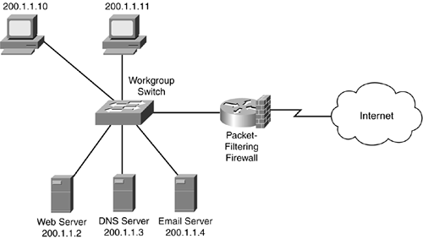
Types of FIREWALLS
Packet-Filtering Router

Slide 10
Applies a set of rules to each incoming IP packet and then forwards or discards the packet.
Filter packets going in both directions.
The packet filter is typically set up as a list of rules based on matches to fields in the IP or TCP header.
Two default policies (discard or forward).

Slide 11
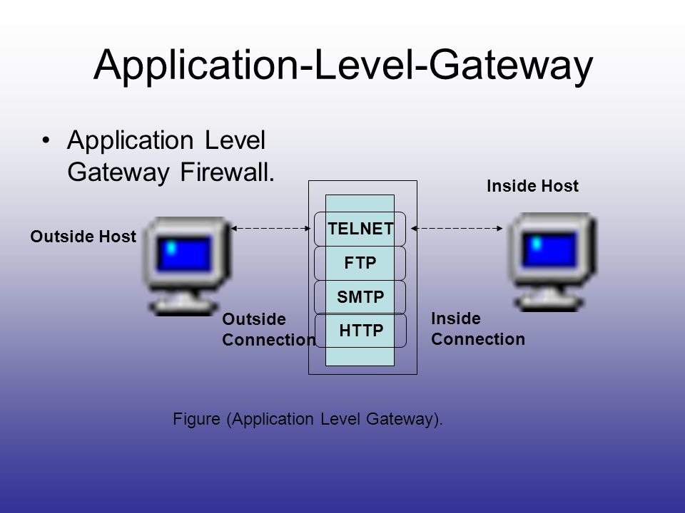
Application-Level Gateway

Slide 12
Also called proxy server.
Acts as a relay of application-level traffic.

Slide 13
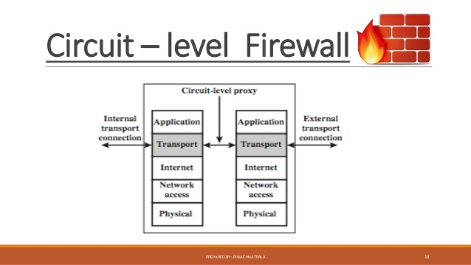
Circuit-Level Gateway

Slide 14
Stand-alone system.
Specialized function performed by an Application-Level Gateway.
Sets up two TCP connections.
The gateway typically relays TCP segments from one connection to the other without examining the contents.
The security function consists of determining which connections will be allowed.

Slide 15
Advantages of a FIREWALL
Concentration of security.
Protocol filtering, where the firewall filters protocols and services that are either not necessary or that cannot be adequately secured from exploitation.
Information hiding.
Application gateways.

Slide 16
Disadvantages of a FIREWALL
Certain types of access may be hampered or even blocked for some hosts, including telnet, ftp, X Windows, NFS, NIS, etc.
It concentrates security in one spot as opposed to distributing it among systems, thus a compromise of the firewall could be disastrous to other less-protected systems on subnet.

Slide 17
THANK YOU

